Slide 1
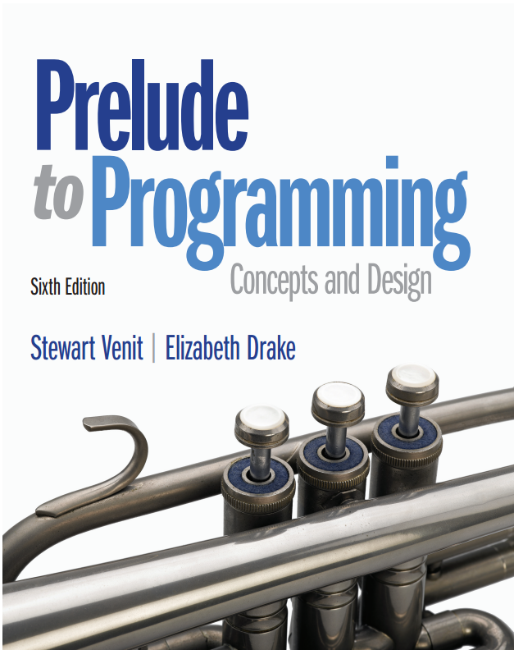
Prelude to Programming
Sixth Edition
Chapter 1
An Introduction to Programming
Copyright © 2015, 2011, 2009 Pearson Education, Inc. All Rights Reserved
Notes:
If this PowerPoint presentation contains mathematical equations, you may need to check that your computer has the following installed:
1) MathType Plugin
2) Math Player (free versions available)
3) NVDA Reader (free versions available)

Slide 2
1.1 What is Programming?

Slide 3
1.1 What is Programming?
A program is a list of instructions that is executed by a computer to accomplish a particular task.
Creating those instructions is programming.
Program development cycle:
Analyze the problem
Design a program to solve the problem
Code the program
Test the program
Revise as necessary

Slide 4
1.2 Basic Programming Concepts

Slide 5
1.2 Basic Programming Concepts
Important concepts:
Pseudocode is used to plan out the logic of a computer program, using English words and phrases.
Input refers to information that is accepted into the program from the user or other sources.
Variables represent values within a program.
Constants are values used within a program. The value of a constant does not change (i.e., it is constant) throughout the program.

Slide 6
Example: The Music Purchase Program
Compute the cost of downloading music online.
Pseudocode used:
Input the number of songs to purchase, Songs
Input Songs
Compute the total cost:
Output the total cost:
Write DollarPrice
Variables used: Songs and DollarPrice
Constants: 0.99

Slide 7
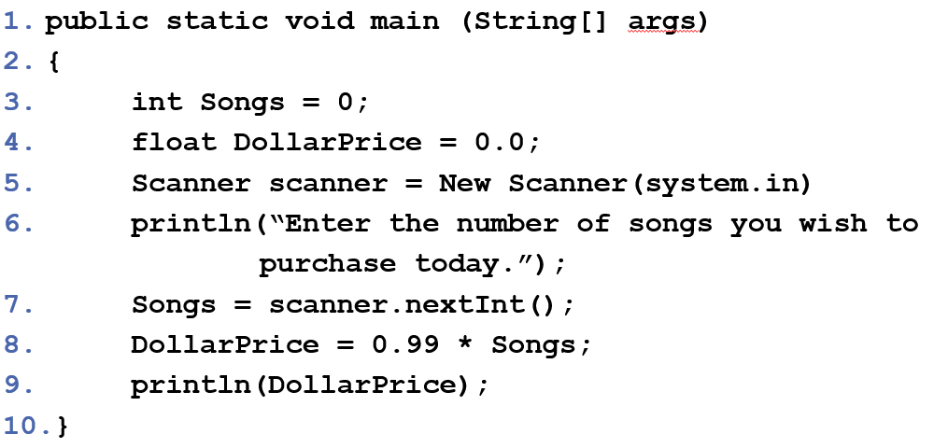
Java Code for the Music Purchase Program

Slide 8
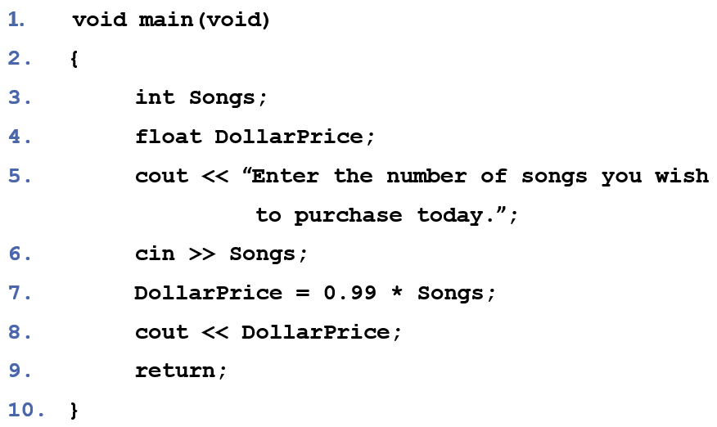
C + + Code for the Music Purchase Program

Slide 9
Data Input
Input operations get data into the programs
A user is prompted for the data to be entered
This text uses the word Write to indicate a prompt for input
The word Input indicates that a user has entered a value
Example:
Write “Enter the number of songs you wish to purchase today.”
Input Songs
Other types of input can be from a file, dragged by mouse, and more

Slide 10
Variables and Constants
Data is input into a program variable.
A variable is a named piece of memory whose value can change during the running of the program.
Example:
Write “Enter the number of songs you wish to purchase today.”
Input Songs
The variable is Songs.
A value which cannot change as the program runs is a constant. In this example, the constant is 0.99.

Slide 11
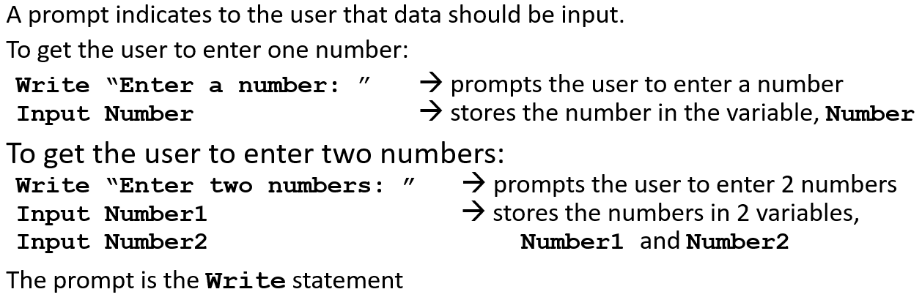
Input Prompts

Slide 12
Naming Variables
All variable names must be one word
Spaces are never allowed
Variables cannot begin with a number
Names should be meaningful
Long names are allowed but names should be as short as possible, yet still be meaningful

Slide 13
Variable Name Examples
Some examples:
Miles_traveled is fine
Miles Traveled is not (space)
TaxRate_1 is fine
1_TaxRate is not (begins with a number)
Variable1 is fine but not meaningful
Z is fine but not meaningful
What’s wrong with these?
My Number
2_4_6_8_go
CowWhoJumpedOverTheMoon
#

Slide 14


What’s really happening?
A variable is the name for a storage location in the computer’s internal memory.
The value of a variable is the contents of that location. The contents of the computer’s memory after the Input statement in the Music Purchase program is executed and the user wants to download 78 songs:
The DollarPrice mailbox is empty - it has not yet been assigned a value. At the end of the program, the contents of memory would be:
Every time you run the program with a different number of songs, the values in the memory locations will change. The contents of the Songs memory “box” will be replaced by the new number of songs and, after the calculation is made, the contents of the DollarPrice memory location will be replaced by the new value.

Slide 15
Try It
Suppose a program is to calculate the final (maturity) value of an investment. You will be given the amount invested, the rate of interest, and the length of time that the money is invested.
a. What data must be input to this program?
b. Give reasonable names for each of the input variables.
c. Give Write and Input statements that prompt for and input the data for this problem.

Slide 16
1.3 Data Processing and Output

Slide 17
1.3 Data Processing and Output
The above statement is a processing statement.
It means to take the value in the variable Songs, multiply it by 0.99, and set the value of the variable DollarPrice to the result of the multiplication.
It is also an assignment statement.
It changes the value of the variable DollarPrice from its previous value to the new value.
Write DollarPrice
This output statement will output the value of DollarPrice to the screen.

Slide 18
Assigning and Reassigning Values to Variables
In a program the following two statements:
Set NumberX = 45
Set NumberX = 97
will first assign the value of 45 to the variable, NumberX and then replace that value with 97.
After these two statements are executed, NumberX contains the value of 97. The value 45 has been lost.

Slide 19
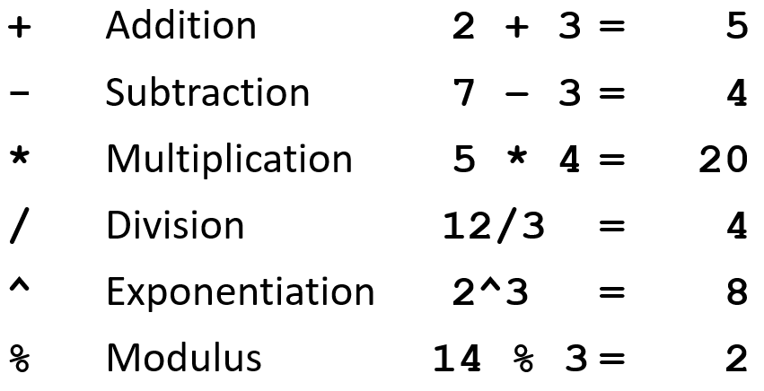
Operations on Data: Arithmetic Operations

Slide 20
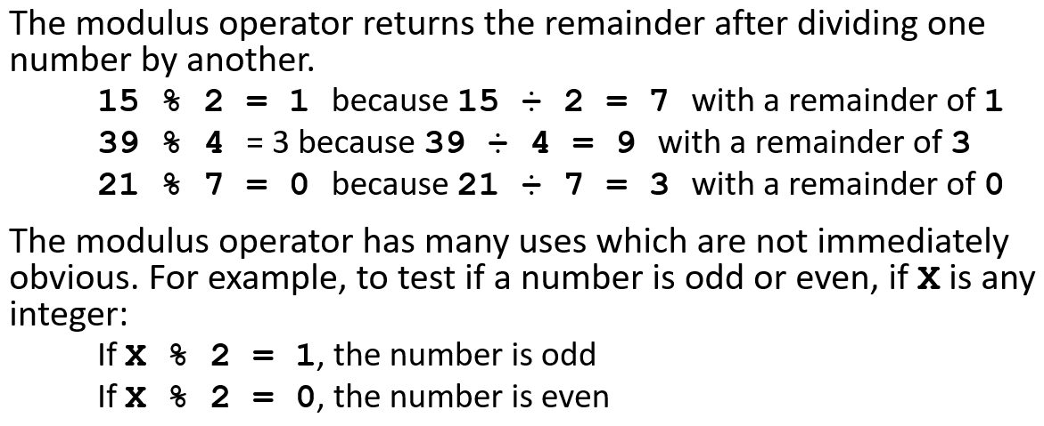
The Modulus Operator

Slide 21
Hierarchy of Operations
First: perform operations inside parentheses (from inside out if more than one)
Second: perform exponentiation
Third: do multiplications, divisions, and modulus from left to right (if there are more than one)
Fourth: do additions and subtractions from left to right (if there are more than one)

Slide 22
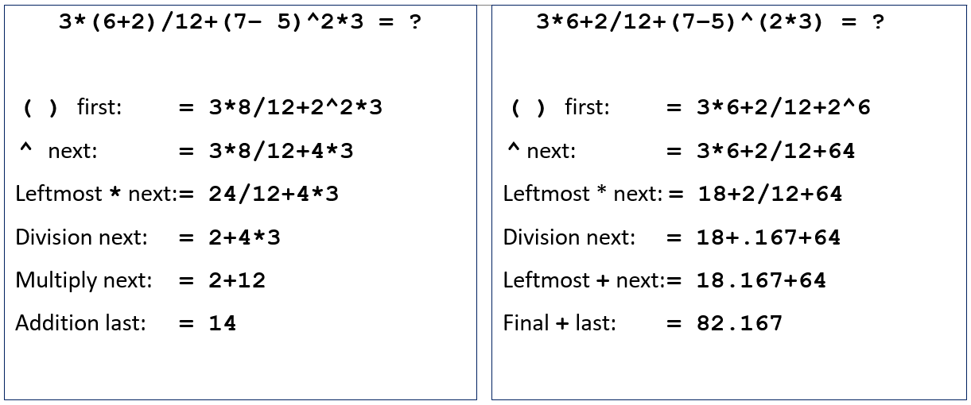
Example of Hierarchy of Operations

Slide 23
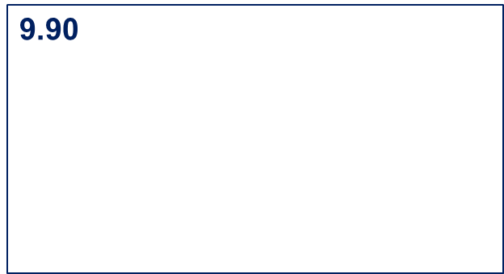
Data Output
Data that is sent from the program to the screen, printer, or to a file is output.
In pseudocode, the following statement will display the value of the variable to the screen and send the cursor to the next line:
Write DollarPrice
If DollarPrice contains the value 9.90, the output on the screen will be:

Slide 24
Annotate the Output
If the output consists of numbers or any data that has no explanatory text with it, you should annotate your output
Annotating output means to add some text so the user knows what the output means.
Example: if Test1 and Test2 are 2 exam scores for a student:
Write “The student’s average is: “
Write Average

Slide 25
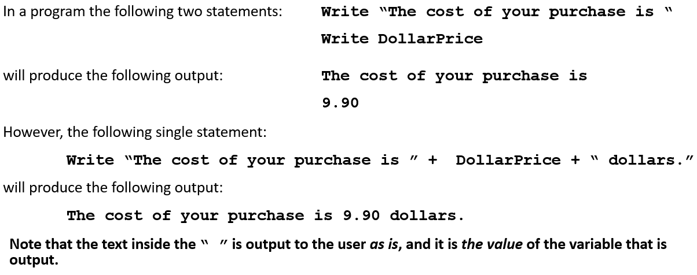
Formatting Output (1 of 2)

Slide 26
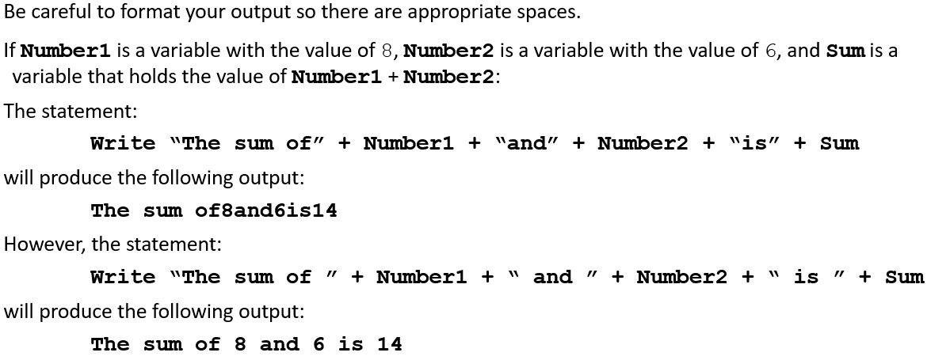
Formatting Output (2 of 2)

Slide 27
1.4 Data Types

Slide 28
1.4 Data Types
Each piece of data (a single character, a number, a paragraph, etc.) is stored in at least one memory location. The amount of space allocated to data initially depends on the data type.
Some languages have many data types, such as integer, floating point data, strings, characters, Boolean types, double, and so on.
Some languages have only a few data types such as numeric and string.
Some languages insist that a data type is declared before it is used and the type can never change. These are called strictly typed languages.
Other languages are not as strict about declaring data types and are called loosely typed.
We will declare our data types in our pseudocode.

Slide 29
The Declare Statement
Variables should be declared to identify their data type.
In this text, a statement such as the following will set aside a space in the computer’s memory to store a variable of a given data type:
Declare VariableName As DataType

Slide 30
Character and String Data
Character data (alphanumerics)
Consists of all the characters you can type at the keyboard
A character string (i.e., a string) is a sequence of characters.
The data type is String or Character
If a variable is of String or Character type, you cannot perform any math operations on it.
However, you can join two Characters or Strings

Slide 31
Declaring Character and String Variables
The following statement declares a variable named Response to be of Character data type:
Declare Response As Character
A Character variable can contain only a single character.
The following statement declares a variable named UserName to be of String data type:
Declare UserName As String
A String variable can contain as many characters as desired but the whole string of characters must be enclosed within the quotes.
Note that spaces, punctuation, and special symbols such as the %, @ , * , and so forth are all considered characters.

Slide 32
Concatenation
If a variable is of String or Character type, you cannot perform any math operations on it.
However, you can join (concatenate) two Characters or Strings:
Given: First, Last, and Full are three String variables
Given: First = “Lizzy” and Last = “Duck”
Then the statement
will assign the value “Lizzy Duck” to Full
Note: The space enclosed in quotes is necessary to put a space between the first and last name when stored in the variable Full.

Slide 33
Integer Data
Integers are all the positive, negative, or zero whole numbers
Examples:
8 is an integer
8.3 is not an integer
-24,567,890 is an integer
0 is an integer
4.0 is not an integer because it has a decimal part

Slide 34
Declaring Integer Variables
Each language has a specific way to declare the data type of its variables.
In this text we use: Declare VariableName As Integer
In C++ and Java: int VariableName;
In Visual Basic: Dim VariableName As Integer
In JavaScript a variable is given a type when it gets its initial value.
Therefore: var VariableName = 0; sets the JavaScript variable to be an integer

Slide 35
Floating Point Variables
All floating point numbers have both an integer part and a fractional part
Examples:
5.65
9.00
-456,784.983
½
Repeating numbers like 0.333333…
Note: 7 is not a floating point number but 7.0 is!

Slide 36
The Declare Statement Revisited
In this text we will declare variables with the following data types:
To declare a variable named Number1 as a floating point variable use:
Declare Number1 As Float
To declare a variable named Number2 as an integer variable use:
Declare Number2 As Integer
To declare a variable named OneLetter as a character variable use:
Declare OneLetter As Character
To declare a variable named OneWord as a string variable use:
Declare OneWord As String

Slide 37
Naming Conventions
Some programmers use specific conventions when naming variables. These are almost always simply a matter of preference.
CamelBack notation examples: | Visual Basic convention examples:
Declare NumberOne As Integer | Dim intNumberOne As Integer
Declare firstName As String | Dim strFirstName As String
Declare Tax_rate As Float | Dim lngTaxRate As Long (Float)

Slide 38
Boolean Data
Named for George Boole who developed the algebra of logic, basic to the design of digital computer circuits.
A variable of Boolean data type can have only one of two values: true or false.
A1 represents true and a 0 represents false.
We use the following pseudocode to declare a Boolean variable:
Declare Status As Boolean
The uses for Boolean variables will become evident as you continue to write programs.

Slide 39
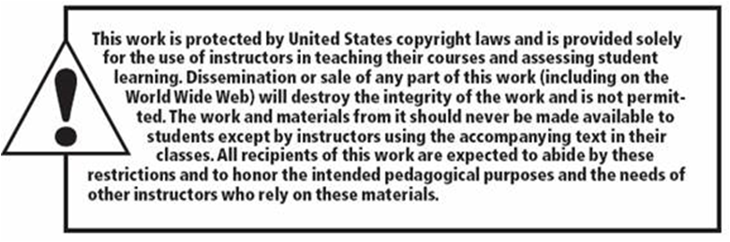
Copyright

